Slide 1
Chapter Three
Analyzing the Marketing Environment

Slide 2
Analyzing the Marketing Environment
Topic Outline
The Company’s Microenvironment
The Company’s Macroenvironemnt
Responding to the Marketing Environment

Slide 3
The Marketing Environment
The marketing environment includes the actors and forces outside marketing that affect marketing management’s ability to build and maintain successful relationships with customers

Slide 4
  Microenvironment - forces close to the company that affect its ability to serve its customers.
  Controllable in short run
  Macro environment - larger societal forces that affect the whole microenvironment.
  Uncontrollable in short run

Slide 5
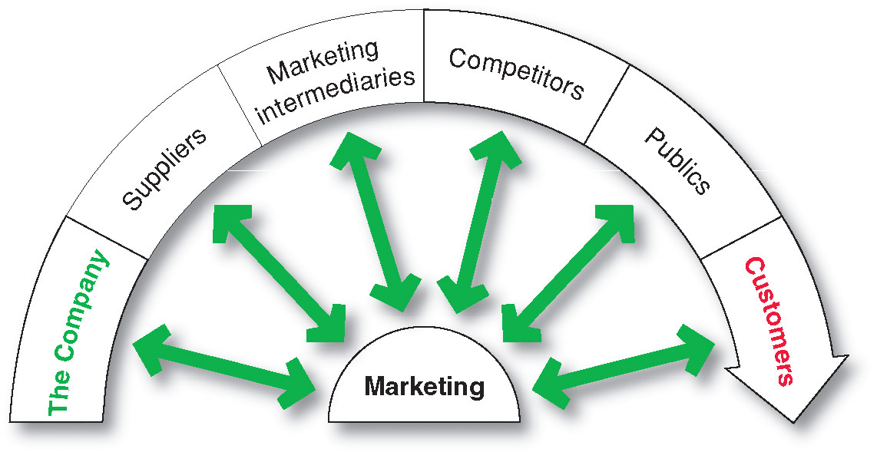
The Company’s Microenvironment
Actors in the Microenvironment

Slide 6
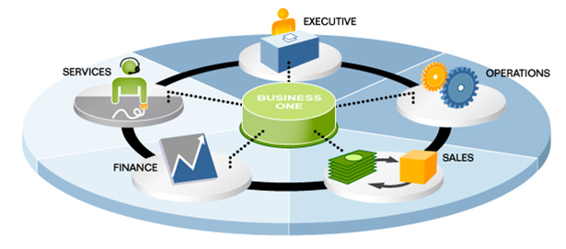
The Company’s Microenvironment
The Company
Notes:
Note to Instructor
Discussion Questions
What types of collaboration does there need to be between the departments?
How might projects be integrated between marketing and finance?
How might projects be integrated between marketing and information systems?
This question on finance could lead to a discussion about budgeting for marketing. The collaboration between marketing and IS could lead to discussions of market research, ordering systems, and customer relationship management systems.

Slide 7

The Company’s Microenvironment
Suppliers
Provide the resources to produce goods and services
Treated as partners to provide customer value

Slide 8
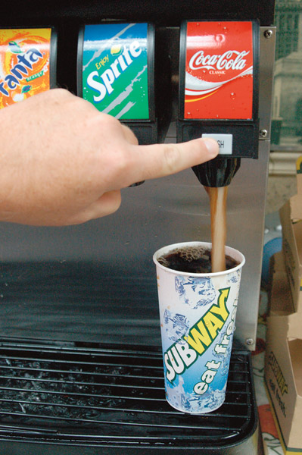
The Company’s Microenvironment
Marketing Intermediaries
Help the company to promote, sell and distribute its products to final buyers
Notes:
Note to Instructor
The text explains how Coke delivers value for their marketing intermediaries:
They understand each retailer partner’s business
The conduct consumer research and share with partners
They develop marketing programs and merchandising for partners

Slide 9

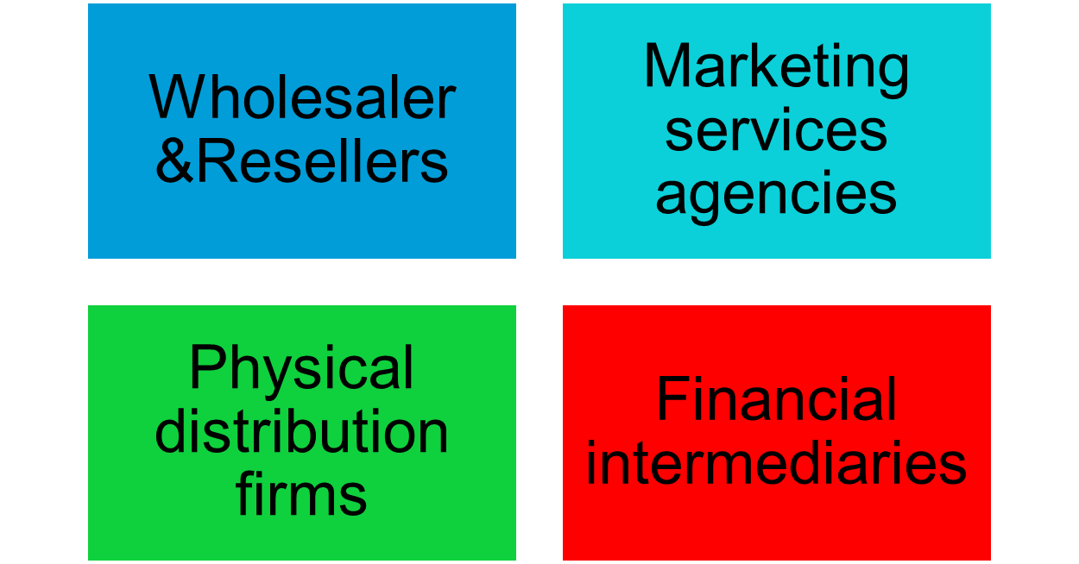

The Company’s Microenvironment
Types of Marketing Intermediaries

Slide 10

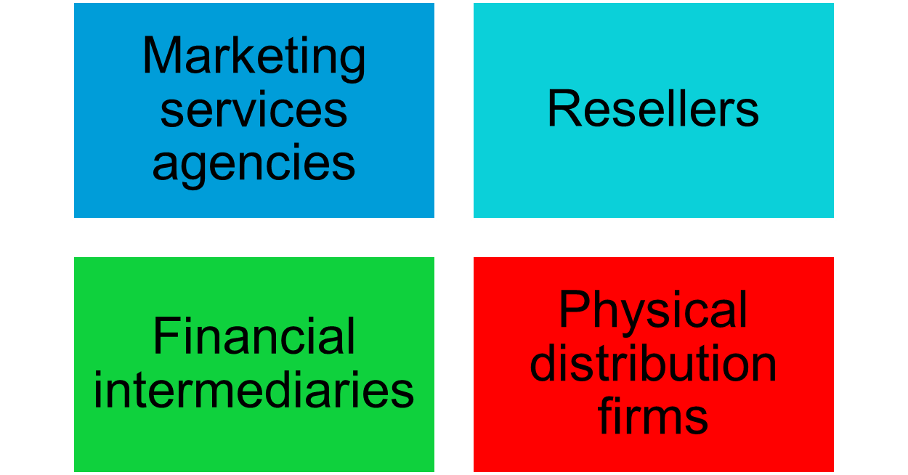

The Company’s Microenvironment
Types of Marketing Intermediaries

Slide 11


The Company’s Microenvironment
Competitors
Firms must gain strategic advantage by positioning their offerings against competitors’ offerings
Notes:
Note to Instructor
Students should note that the competition is just a click away with online purchasing. This link goes to Bizrate—one of many comparison shopping sites online. Enter a product like coffee makers to see the competing products and retailers for this category.

Slide 12
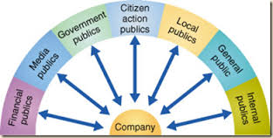
The Company’s Microenvironment
Publics
Any group that has an actual or potential interest in or impact on an organization’s ability to achieve its objectives
Notes:
Note to Instructor
In slideshow view, click on movie icon to launch Tom’s Shoes video snippet. See accompanying DVD for full video segment.

Slide 13



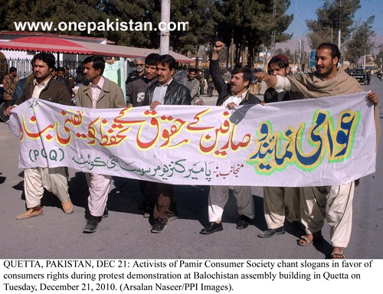



Publics
Notes:
Note to Instructor
In slideshow view, click on movie icon to launch Tom’s Shoes video snippet. See accompanying DVD for full video segment.

Slide 14
The Company’s Microenvironment
Customers
Personal Customer –
Organizational Customer –
Notes:
Note to Instructor
Students should note that the competition is just a click away with online purchasing. This link goes to Bizrate—one of many comparison shopping sites online. Enter a product like coffee makers to see the competing products and retailers for this category.

Slide 15
Customer Markets
International
Markets
Consumer
Markets
Company
Government
Markets
Business
Markets
Reseller
Markets
Notes:
Customer Markets
This CTR corresponds to Figure 3-2 on p. 73 and relates to the material on p. 72.
Types of Customer Markets
The company is concerned with five types of customer markets, including:
Consumer Markets. These consist of individuals and households that buy goods and services for personal consumption.
Business Markets. These buy goods and services for further processing or for use in their production process.
Reseller Markets. Resellers buy goods and services for repackaging and reselling at a profit.
Discussion Note: Students may have heard that these “middlemen” raise costs to end-users. You might point out that in most cases, resellers actually lower costs by performing marketing functions less expensively than could manufacturers.
Government Markets. Governments buy goods and services to produce public services or to transfer them to needy constituents.
International Markets. A growing concern for almost all marketers, these consist of those various types of buyers located in other countries.

Slide 16
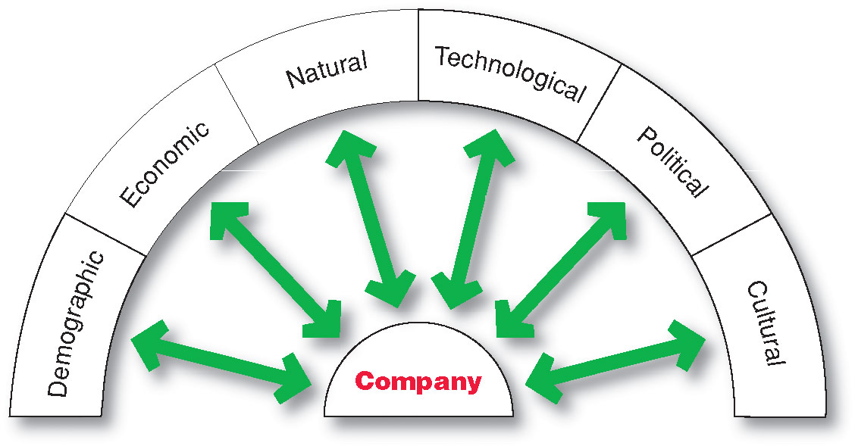
The Company’s Macroenvironment

Slide 17
The Company’s Macroenvironment
Demographic Environment
Demography is the study of human populations in terms of size, density, location, age, gender, race, occupation, and other statistics
Demographic environment is important because it involves people, and people make up markets
Demographic trends include age, family structure, geographic population shifts, educational characteristics, and population diversity

Slide 18
Key Demographic Trends
Increase in population
Population is increasing rapidly
Growing Middle Class
Marrying later, fewer children,
working women
Geographic Shifts
Moving to the new areas
Increased Education
Increased college attendance
and white-collar workers
Growing Racial Diversity
Notes:
Demographic Environment
Demography is the study of human populations in terms of size,
density, location, age, sex, race, occupation, and other aggregate statistics.
Key Aspects of the US demographic environment include:
Age Structures (esp.. Baby Boomers). The post W.W.II Baby Boom is the most
significant demographic feature by its sheer size: 75 million or over 1/3
of the US population. This bulge in age distribution leads growth strategies
in industries serving age-specific markets. Where boomers go, marketers
must follow.
Discussion Note: More proactively, marketers need to identify emerging boomer
needs to plan strategically for an aging population that also lives longer than
previous ones.
Family Structure. The typical American family rarely exists anymore.
Increasing age of those marrying, delayed child-bearing, increased two-
income families, and non-family households are key demographic trends.
Geographic Population Shifts. Americans are mobile. Trends include
movement to Sunbelt states, rural to urban shifts, and present urbanites
moving to suburbs.
Trends in Education. Americans are becoming more educated and white-collar.
Increasing Ethnic Diversity. The United States population is 73% white,
12% black, with the remaining percentage mostly Hispanic (22 million) and
Asian (7 million).
Key U.S. Demographic Trends
This CTR relates to the material on pp. 74-79.

Slide 19
The Company’s Macroenvironment
Economic Environment
Economic environment consists of factors that affect consumer purchasing power and spending patterns
Industrial economies are richer markets
Subsistence economies consume most of their own agriculture and industrial output

Slide 20
Economic Environment
Global Financial
Crises
Changes
in Income
Key
Economic
Concerns for
Marketers
Changes
in Consumer
Spending
Patterns
Notes:
Economic Environment
This CTR relates to the material on pp. 79-82.
The Economic Environment
The Economic Environment consists of factors that affect consumer purchasing power and spending patterns. Key considerations include:
Economic Development. Nations vary greatly in their levels of and distribution of income, often as a result of their stage of economic development. Typical distinctions include:
Subsistence Economies. These consume most of their own agricultural and industrial output. These countries are poor targets for most products.
Industrial Economies. These offer rich markets for many different kinds of goods.
Changes in Income. Rising incomes for most consumers have only kept pace with inflation. As a result, consumers are more sensitive to Value Marketing - the careful promotion of a high degree of quality and performance for the price. Income distribution is also of key importance: Upper-class consumers are not affected by current economic events. Middle-class consumers can afford the “good life” most of the time, but are careful about spending. Working-class consumers must budget carefully. Underclass consumers are often unable to participate fully in the marketing system.
Changing Consumer Spending Patterns. Knowledge of Engel’s Laws remains important: As income rises, the percentage spent on food declines, the percentage spent on housing remains constant, and the percentage spent on savings and other categories increases.

Slide 21
The Company’s Macroenvironment
Natural Environment
Natural environment involves the natural resources that are needed as inputs by marketers or that are affected by marketing activities
Notes:
Note to Instructor
This Web link connects to greenbiz.com. There are several Web sites like this that provide information on business as to how to practice green strategies including green marketing.

Slide 22


Natural Environment Trends
More Government
Intervention
Natural
Environment
Higher Pollution
Levels
Shortages of
Raw Material
Increased Costs
of Energy
Notes:
Natural Environment
There are several areas affecting marketing that stem from the natural environment.
Shortages of Raw Materials. Shortages both increase demand and sprout counter-movements aimed at conservation.
Discussion Note: Both sides of the "green" movement utilize sophisticated database marketing and lobbying techniques.
Energy Costs. The cost of energy makes long-term growth of high energy industries and goods difficult to predict.
Increased Pollution. Industrial growth almost always damages the natural environment. The so-called “green movement” seeks to operate businesses in such a way so as not to damage the natural environment. The varying political power of “greens” in different countries is a consideration in global marketing efforts.
Government Intervention in Natural Resource Management. Changing philosophies on the role of government in managing natural resources also blends into the legal environment. Marketers must take care in identifying natural environmental trends.
Discussion Note: You might further expand this discussion by pointing out that even agencies like the EPA vary greatly in the amount of environmental regulation they perform depending upon funding and the agenda of whoever occupies the White House.

Slide 23

The Company’s Macroenvironment
Technological Environment
Most dramatic force in changing the marketplace
Creates new products and opportunities
Notes:
Note to Instructor
Discussion Question
Ask students what changes they have seen in technology in the past four years including medical products, communications, and media.
They will most likely talk about the use of artificial organs and stem cell research, the growth of PDA’s like the iPod, and the use of new media products including DVR or TiVo.

Slide 24
The Company’s Macroenvironment
Political Environment
Political environment consists of laws, government agencies, and pressure groups that influence or limit various organizations and individuals in a given society.

Slide 25
The Company’s Macroenvironment
Political Environment
Legislation regulating business
  Increased legislation
  Changing government agency enforcement
Increased emphasis on ethics
  Socially responsible behavior
  Cause-related marketing

Slide 26
The Company’s Macroenvironment
Cultural Environment
Cultural environment consists of institutions and other forces that affect a society’s basic values, perceptions, and behaviors

Slide 27
The Company’s Macroenvironment
Cultural Environment
Persistence of Cultural Values
Core beliefs and values are persistent and are passed on from parents to children and are reinforced by schools, churches, and government
Secondary beliefs and values are more open to change and include people’s views of themselves, others, organization, society, nature, and the universe

Slide 28
Responding to the Marketing Environment
Three kind of companies,
Those who make things happen
Those who watch things happen
Those who wonder what’s happened?
Environmental Management Perspective
    Taking a proactive approach
    Hire lobbyists
    run advertorials (advertising + editorials)

Slide 29
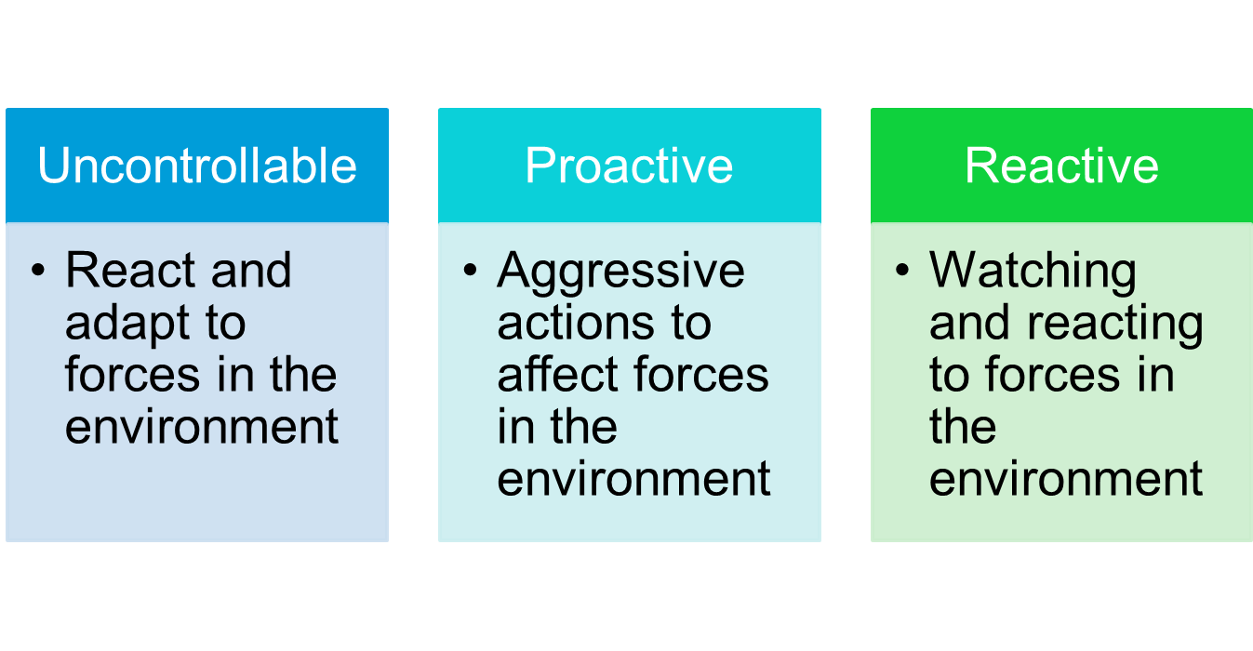
Responding to the Marketing
Environment
Views on Responding

